Slide 1
Welcome

Slide 2
Pyramids of Egypt(2D)
Md. Sirazul Munir id: 011142064
Tabassum Siraj id: 011141027

Slide 3
Project Description
A program to display modeling transformation effects on a scenery.

Slide 4
Key Points
Three Pyramids
Desert
Cactus
Sky
Cloud
Sun
Moon
Day vision
Night vision
Dynamic movement of cloud, sun, moon, day, night.

Slide 5
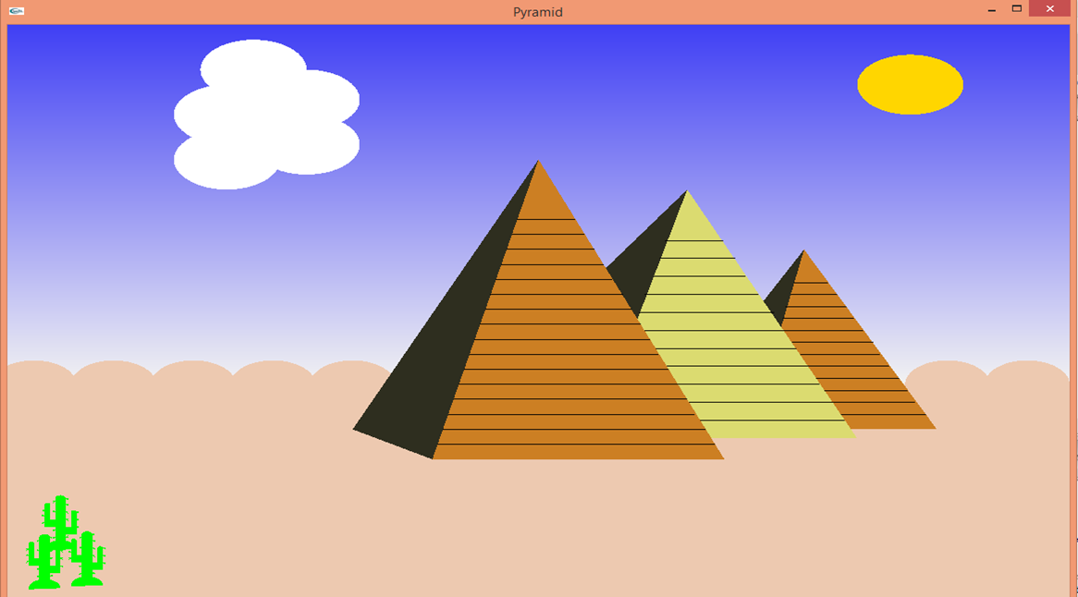
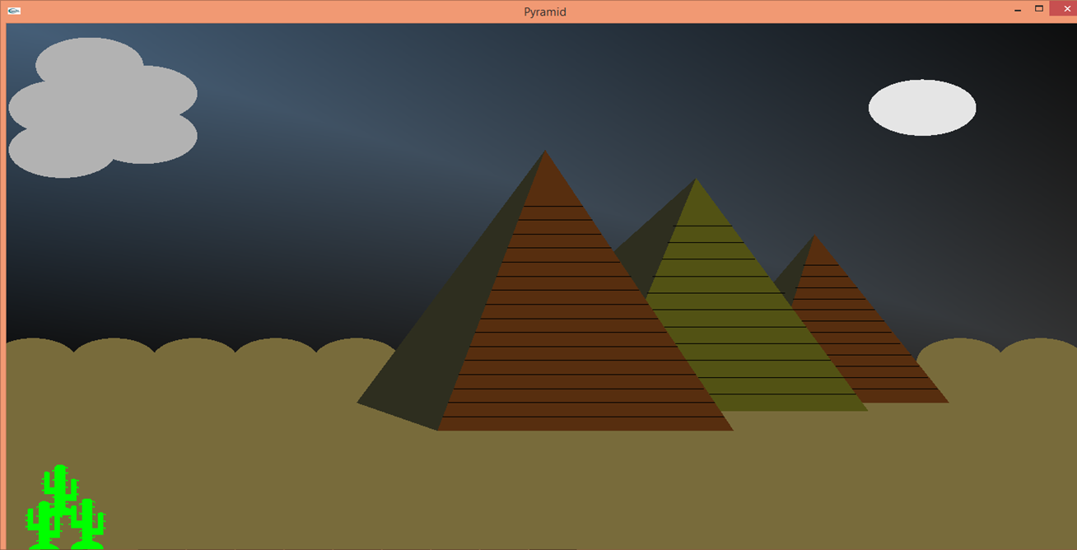
Snap Shots
Pyramid at Day Light
Pyramid at Night

Slide 6
Thank You

